Slide 1


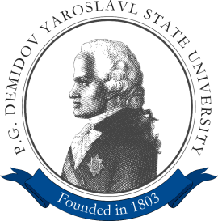


The 23rd Conference of
Open Innovations Association - FRUCT
Bologna, Italy, 15 November 2018
Comparison of Different
Convolutional Neural Network Architectures
for Satellite Image Segmentation
Vladimir Khryashchev
Leonid Ivanovsky
Vladimir Pavlov
Anna Ostrovskaya
Anton Rubtsov

Slide 2
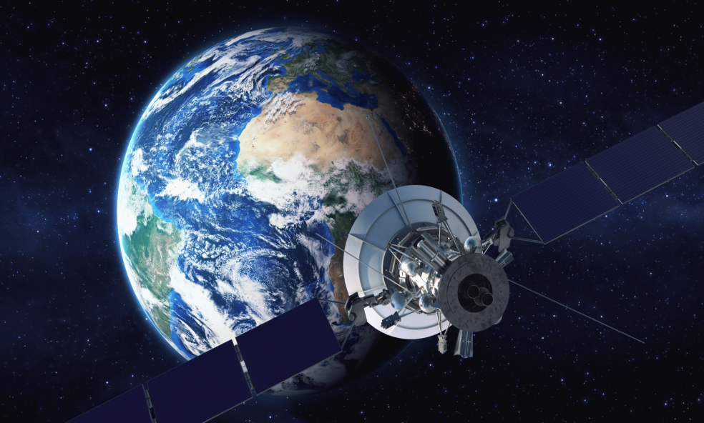
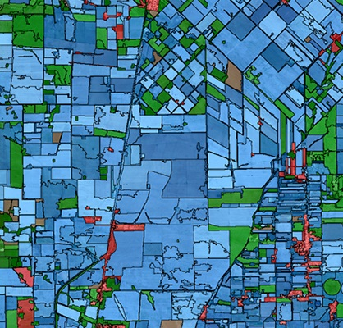
Purpose
Development of efffective algorithm for satellite image segmentation based on deep convolutional neural network

Slide 3
Algorithm requirements
Taking into account the small spatial extent of objects
Being invariant to rotation
Having sufficient amount of training images
Being able to work with high-resolution images

Slide 4
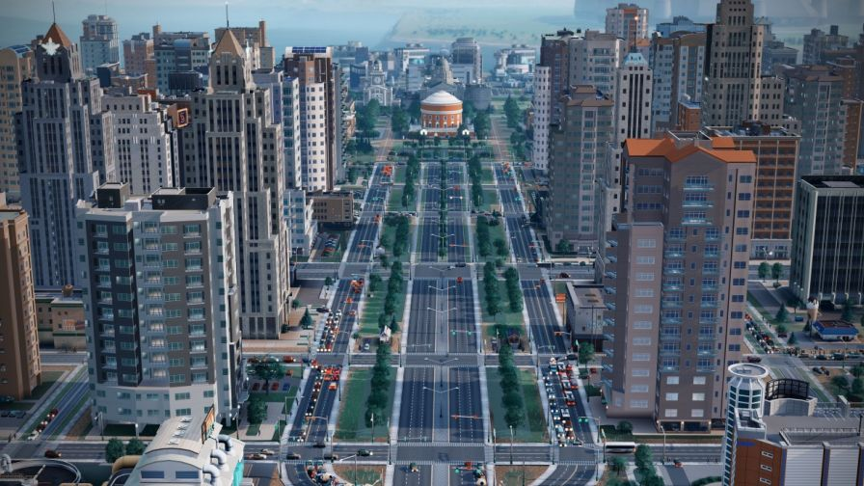
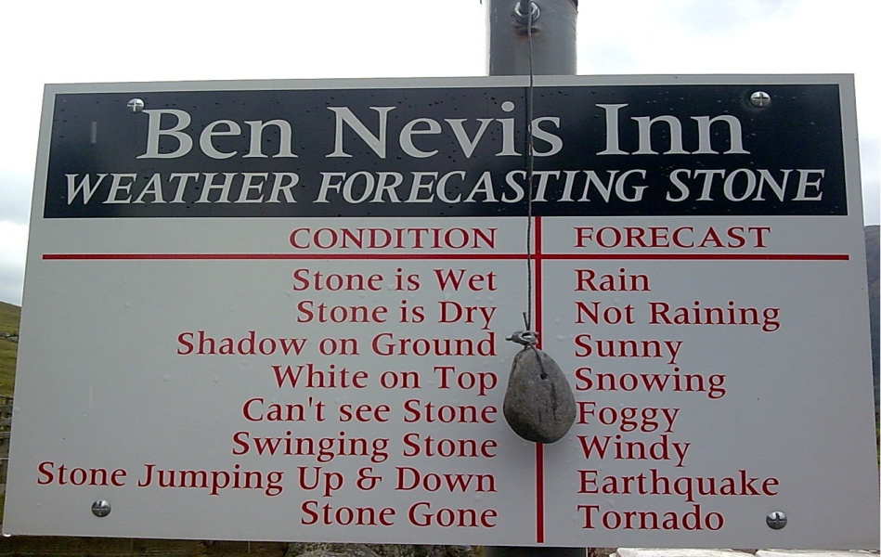
Application areas
Urban planning
Forest management
Climat modelling
Land-use in agriculture

Slide 5
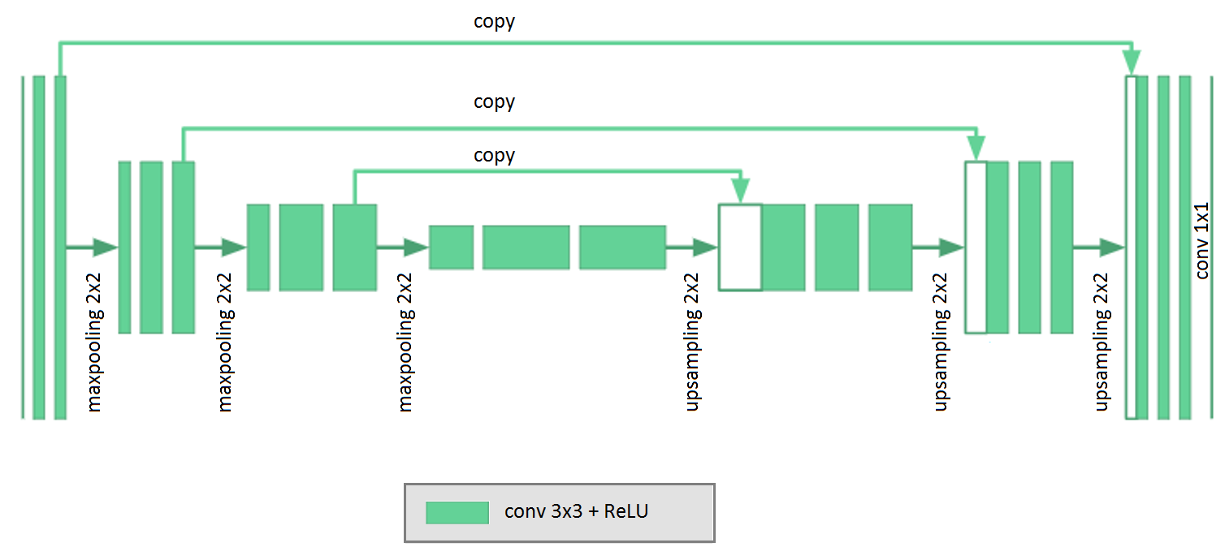
U-Net

Slide 6
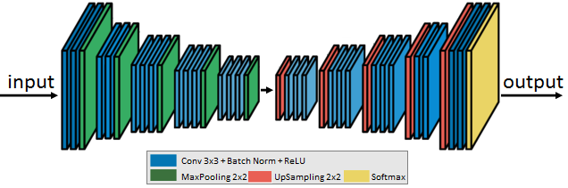
SegNet

Slide 7
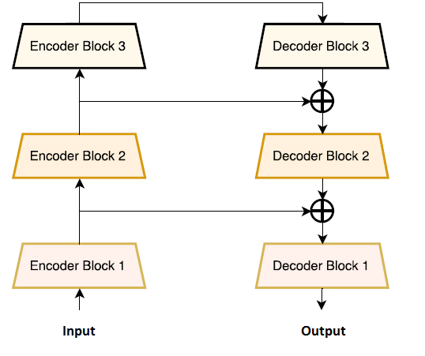
TLinkNet

Slide 8
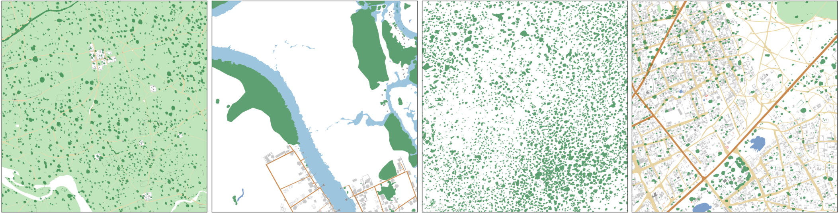
DSTL database
50 samples in GEOTIFF format
Image resolution: >3300x3300 px (1 km x 1 km)
10 different classes
Masks: stored in csv file
DSTL Satellite Imagery Feature Detection:
https://www.kaggle.com/c/dstl-satellite-imagery-feature-detection

Slide 9
DSTL sampling
Training set: 3955 images
Test set: 600 photos
Cropped image resolution: 160x160 px
3 classes: “water”, “forest”, “agriculture”

Slide 10
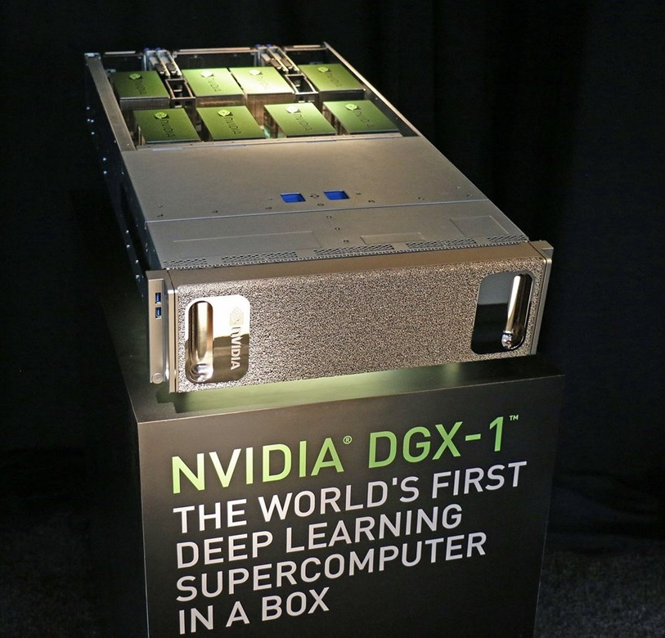

Training and testing
Training: ~1 h
Loss function: binary cross-entropy
Optimizer: Adam
Epochs (E): 256

Slide 11
Numerical results on DSTL sampling
Model | Detection accuracy
SegNet | 93,59%
TLinkNet | 94.53%
U-Net | 94.66%
Model | Dice coefficient (DSC)
SegNet | 0.45
TLinkNet | 0.68
U-Net | 0.75

Slide 12
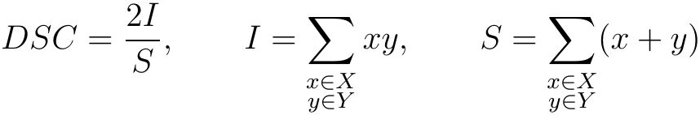
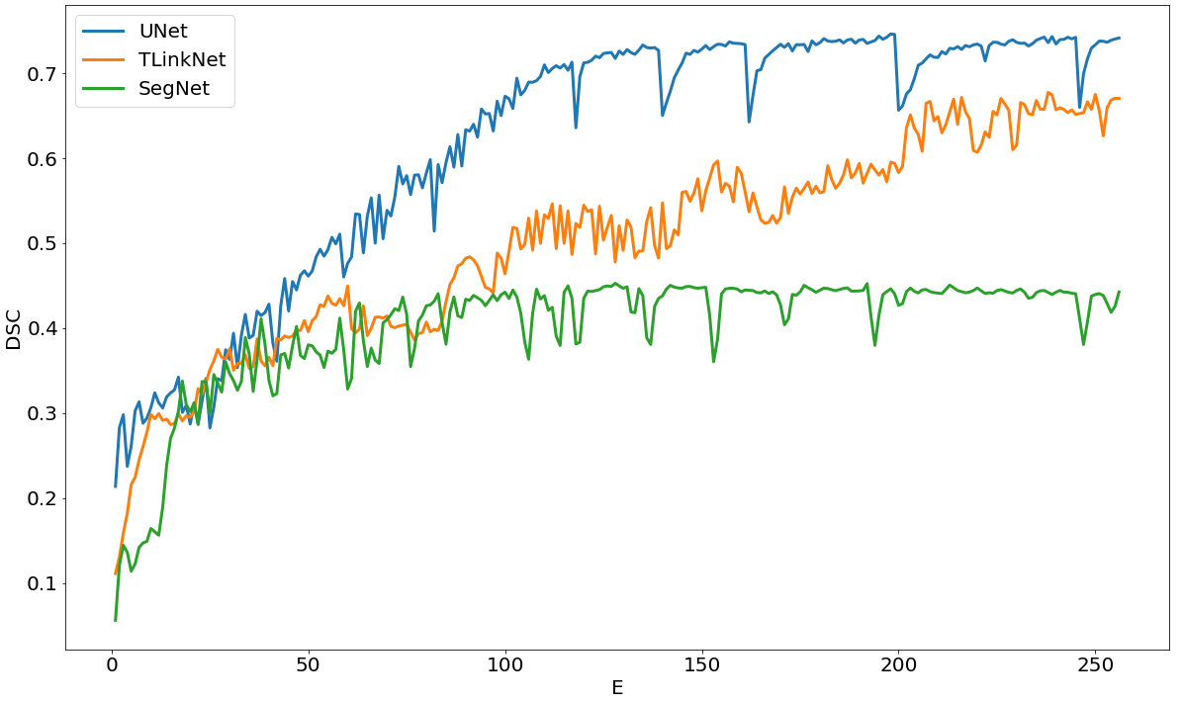
Numerical results on DSTL sampling

Slide 13
PlanetScope database
30 samples in GEOTIFF format
Image resolution: 8600x5800 px (26km x 17.5 km)
Marking: web-application “Supervise”, 3 experts

Slide 14
Dataset preparation
Cropped image resolution: 224x224 px
3 classes: “water”, “forest”, “agriculture”
Sampling: PlanetScope + Landsat-8

Slide 15
Numerical results
Class | Landsat-8 |  | PlanetScope
 | Detection accuracy | Average percentage of intersection | Detection accuracy | Average percentage of intersection
Forest | 89.03% | 92.54% | 92.14% | 93.21%
Water | 90.87% | 81.64% | 90.98% | 82.14%
Agriculture | 94.35% | 96.32% | 96.52% | 96.88%

Slide 16
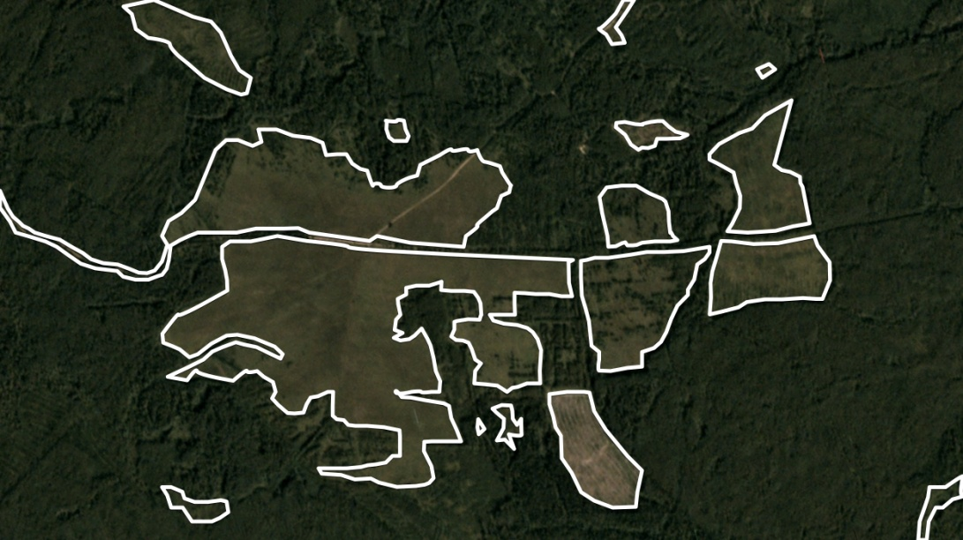
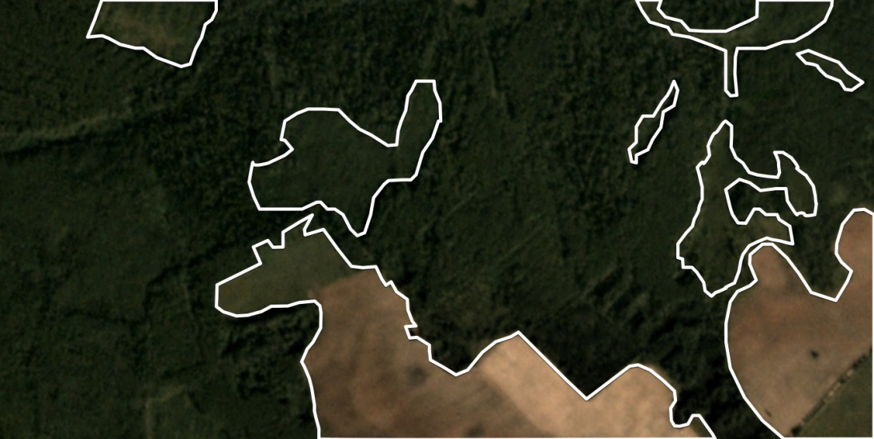
Examples of detection on PlanetScope

Slide 17
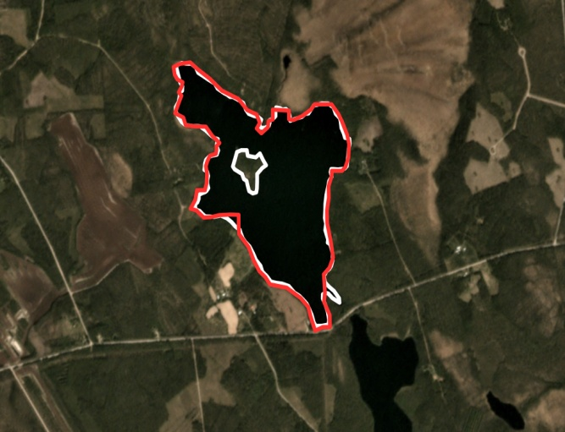
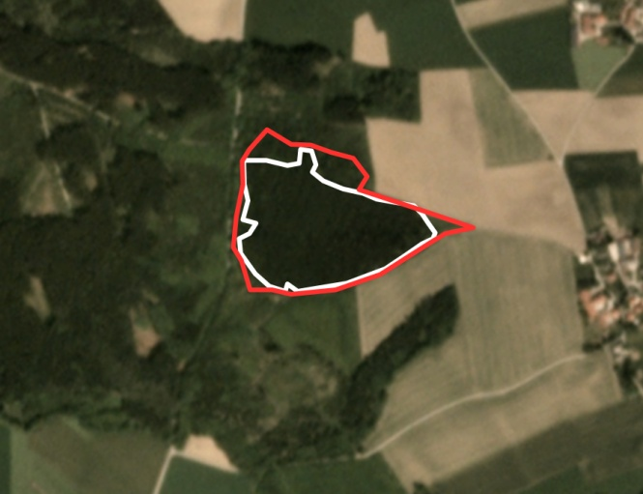
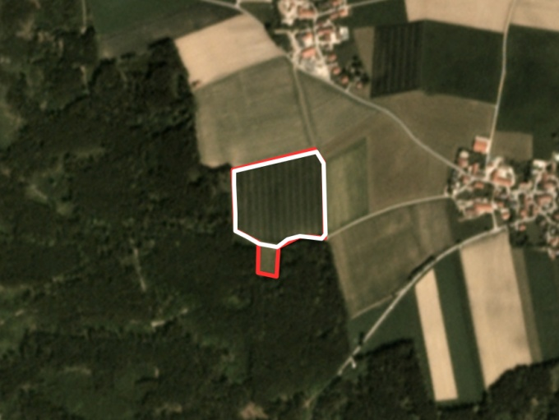
Comparison with expert annotations
water
forest
agriculture
Experts
Algorithm

Slide 18
Conclusions
The use of complicated CNN increases the quality of satellite image segmentation
Dice similarity coefficient (DSC) shows the difference in application of various algorithms
The best performance was given by using U-Net

Slide 19
The 23rd Conference of
Open Innovations Association - FRUCT
Bologna, Italy, 15 November 2018
Comparison of Different
Convolutional Neural Network Architectures
for Satellite Image Segmentation
Vladimir Khryashchev
Leonid Ivanovsky
Vladimir Pavlov
Anna Ostrovskaya
Anton Rubtsov

